Slide 1

Linux Command Line

Slide 2
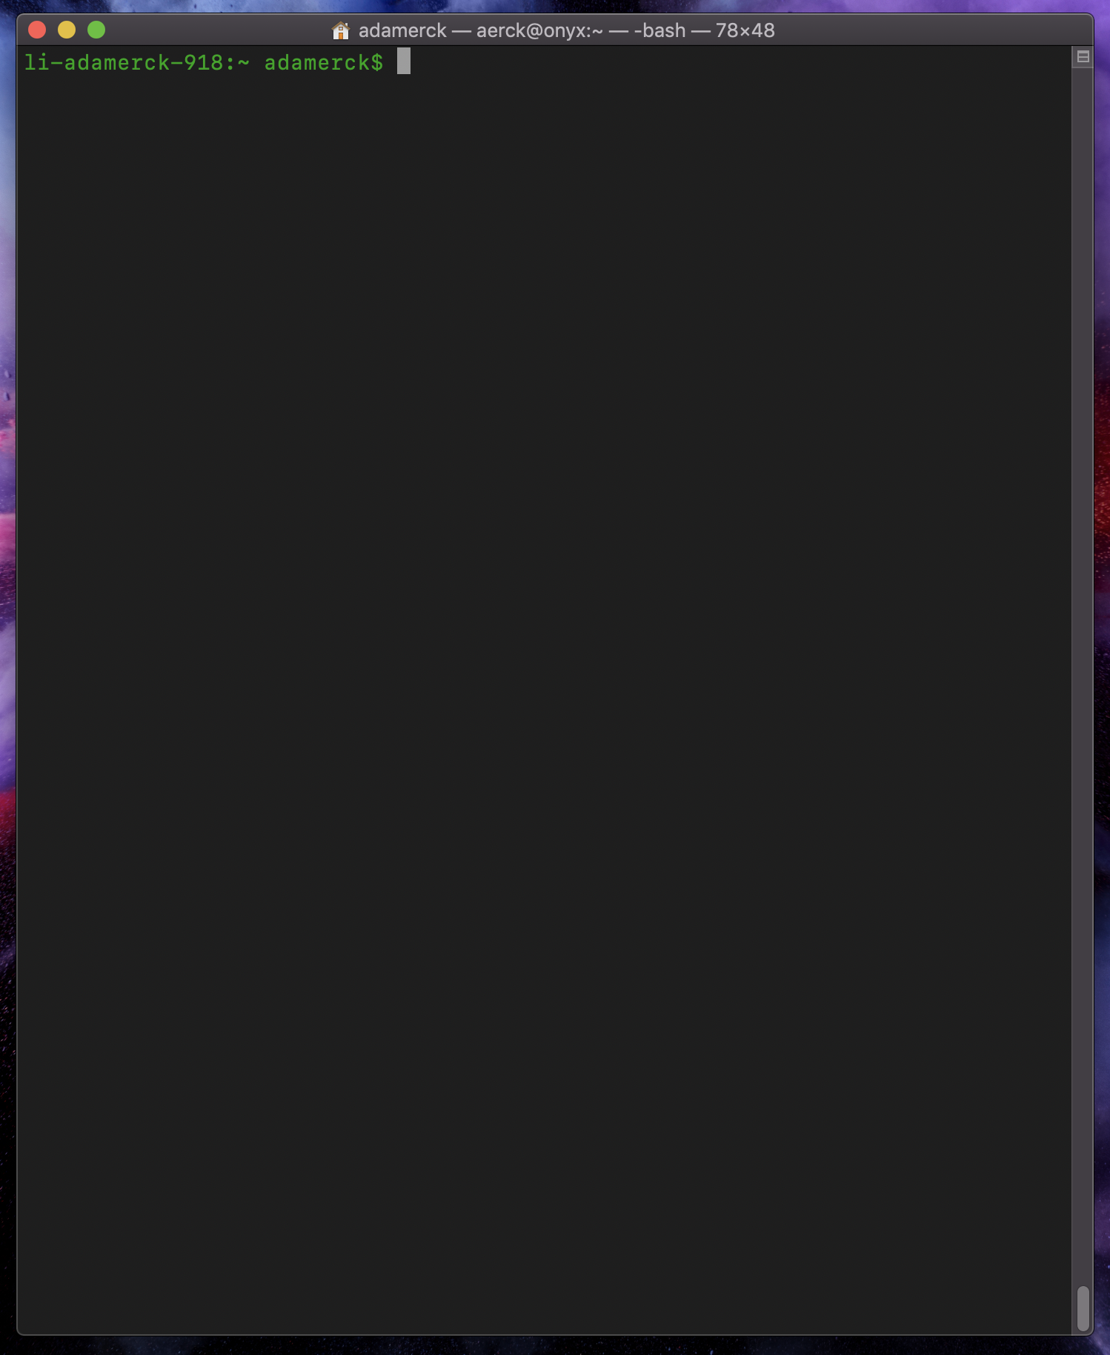
Find a Terminal
Linux Computers: Use the Terminal
Mac Computers: Use the Terminal
Windows Computers: Install MobaXterm from https://mobaxterm.mobatek.net/

Slide 3
A Few Notes
Some results will vary based on the computer and operating system version you are using.
We will be using a “Bash” environment to communicate with a computer.
Note: A Directory is the same as a Folder
Programmers do not like to type, so commands used in the Command Line Interface are typically shortened versions of the words used to describe the command.
For Example:
List files and directories with “ls”
Move files and directories with “mv”
Make a new Directory with “mkdir”

Slide 4
The Basics
What am I looking at here? The Prompt computername:location-username$
The prompt will look different depending on the computer you are using.

Slide 5
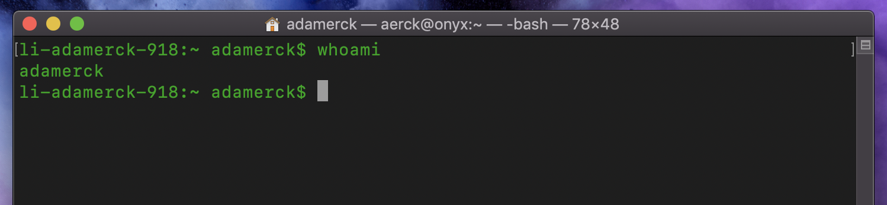
The Basics
Who am I? Type “whoami”

Slide 6
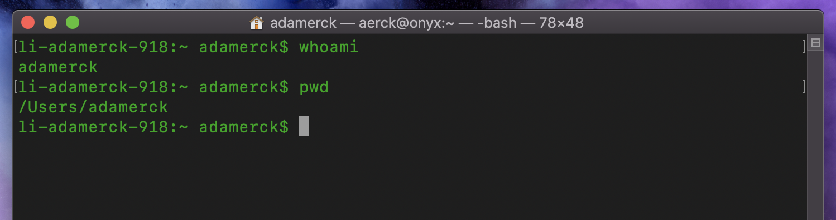
The Basics
Where am I? Type “pwd” for print working directory

Slide 7
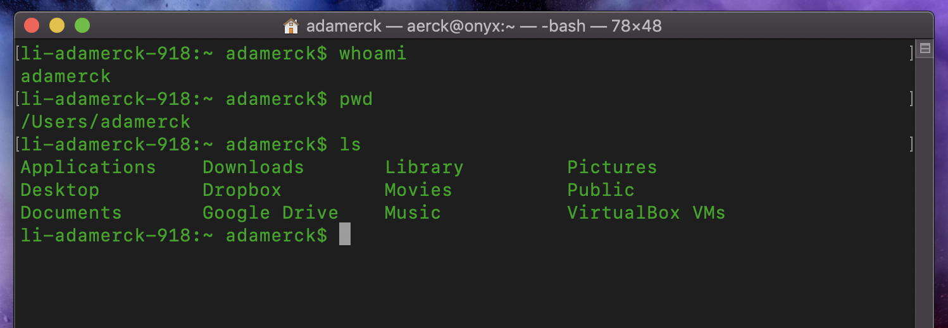
The Basics
What’s in here with me? Type “ls” to list what is in your current directory

Slide 8
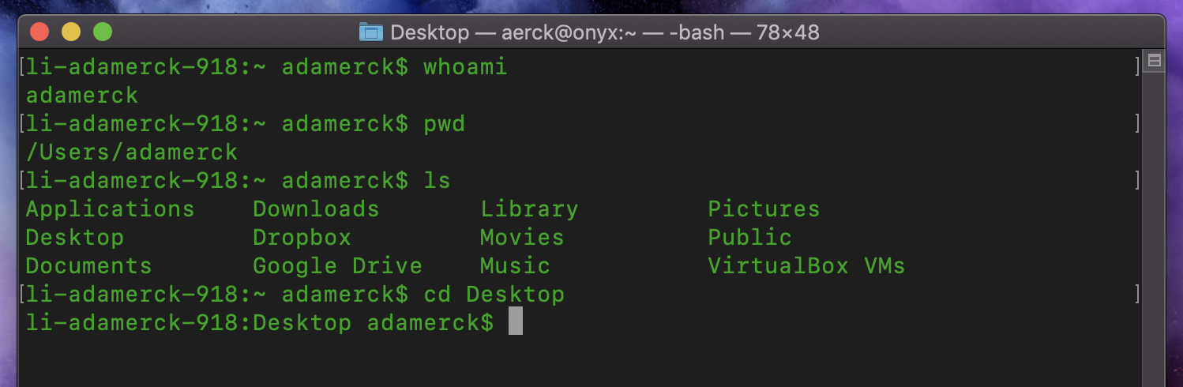
The Basics
Next, let us move around a bit and learn to interact with our environment.
Type “cd Desktop” to Change Directory (hence “cd”) to the Desktop, which should work on all systems.
We will work in the Desktop Directory as it will make it easier to see what we are doing as we go.

Slide 9
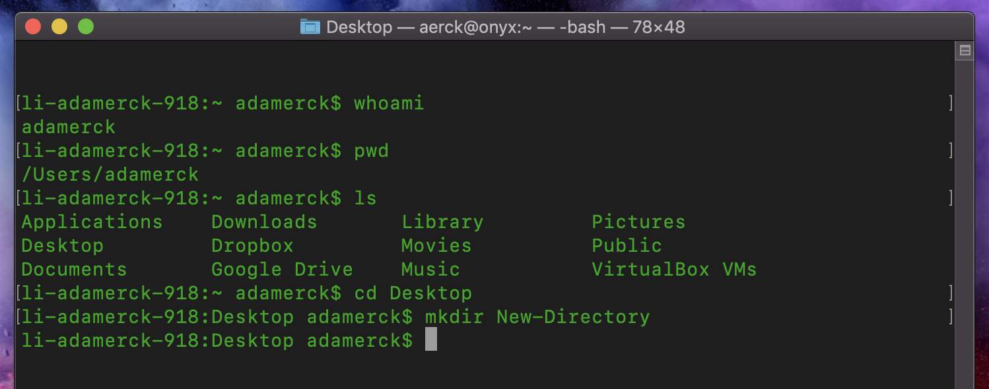
The Basics
Now we should make a new directory with “mkdir New-Directory”.
As we can now see on the Desktop a new folder named New-Directory has been created.
Next make a new file with “touch My-Homework.txt”
The “touch” command is a simple way to create an empty file.

Slide 10
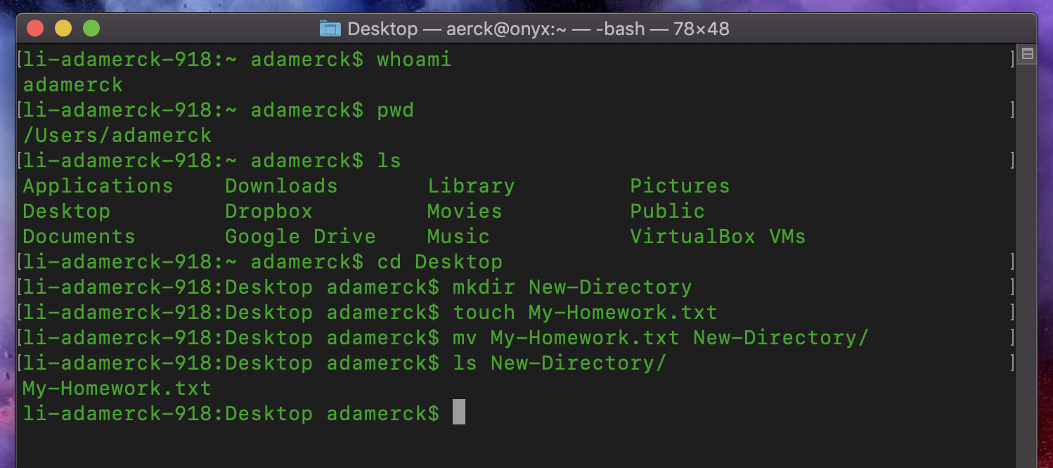
The Basics
Seeing as we are nice people, lets keep our desktop clean by moving our My-Homework.txt file to our New-Directory folder.
Type “mv My-Homework.txt New-Directory”
Verify My-Homework.txt is in New-Directory with “ls New-Directory/”

Slide 11
The Basics
Great Work! You have now completed the basics of the Command Line Interface!
Helpful tips to remember:
Type “pwd” to see where you are in the file system.
Type “cd” by itself to return to your home directory in case you get lost.

Slide 12
Intermediate
A few things to make your life easier:
Hit the up-arrow to see the previous commands in your history, from most recent to oldest
Tab-Auto-Complete is your new best friend.
Start typing a command or file/directory name and hitting the “tab” key will attempt to auto-complete the word.

Slide 13
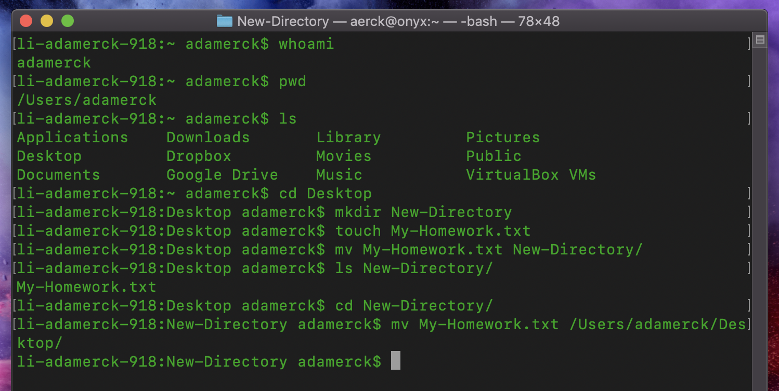
Intermediate
Now what if we needed to move our homework file back to the desktop?
From our current location we would need to type “mv My-Homework.txt /Users/adamerck/Desktop/”
This is rather tedious even with Tab-Auto-Complete, and tedious tasks are where people make mistakes

Slide 14
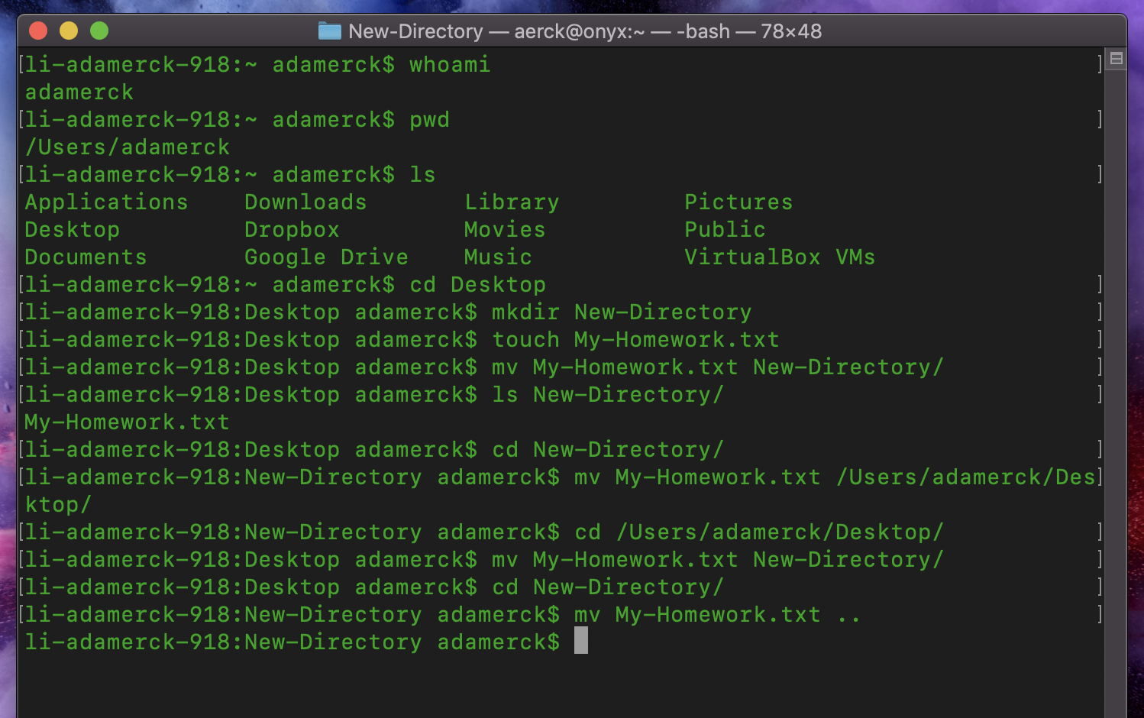
Intermediate
I’m going to undo that last move of our Homework file.
Linux-like systems have a lot of shortcuts baked in for us, again, because programmers do not like typing
The two most useful being:
“.” Which means this directory
“..” Which means the parent directory of this directory, or the directory “above/outside” of this directory
This makes moving our homework file back out to the Desktop much easier “mv My-Homework.txt ..”

Slide 15
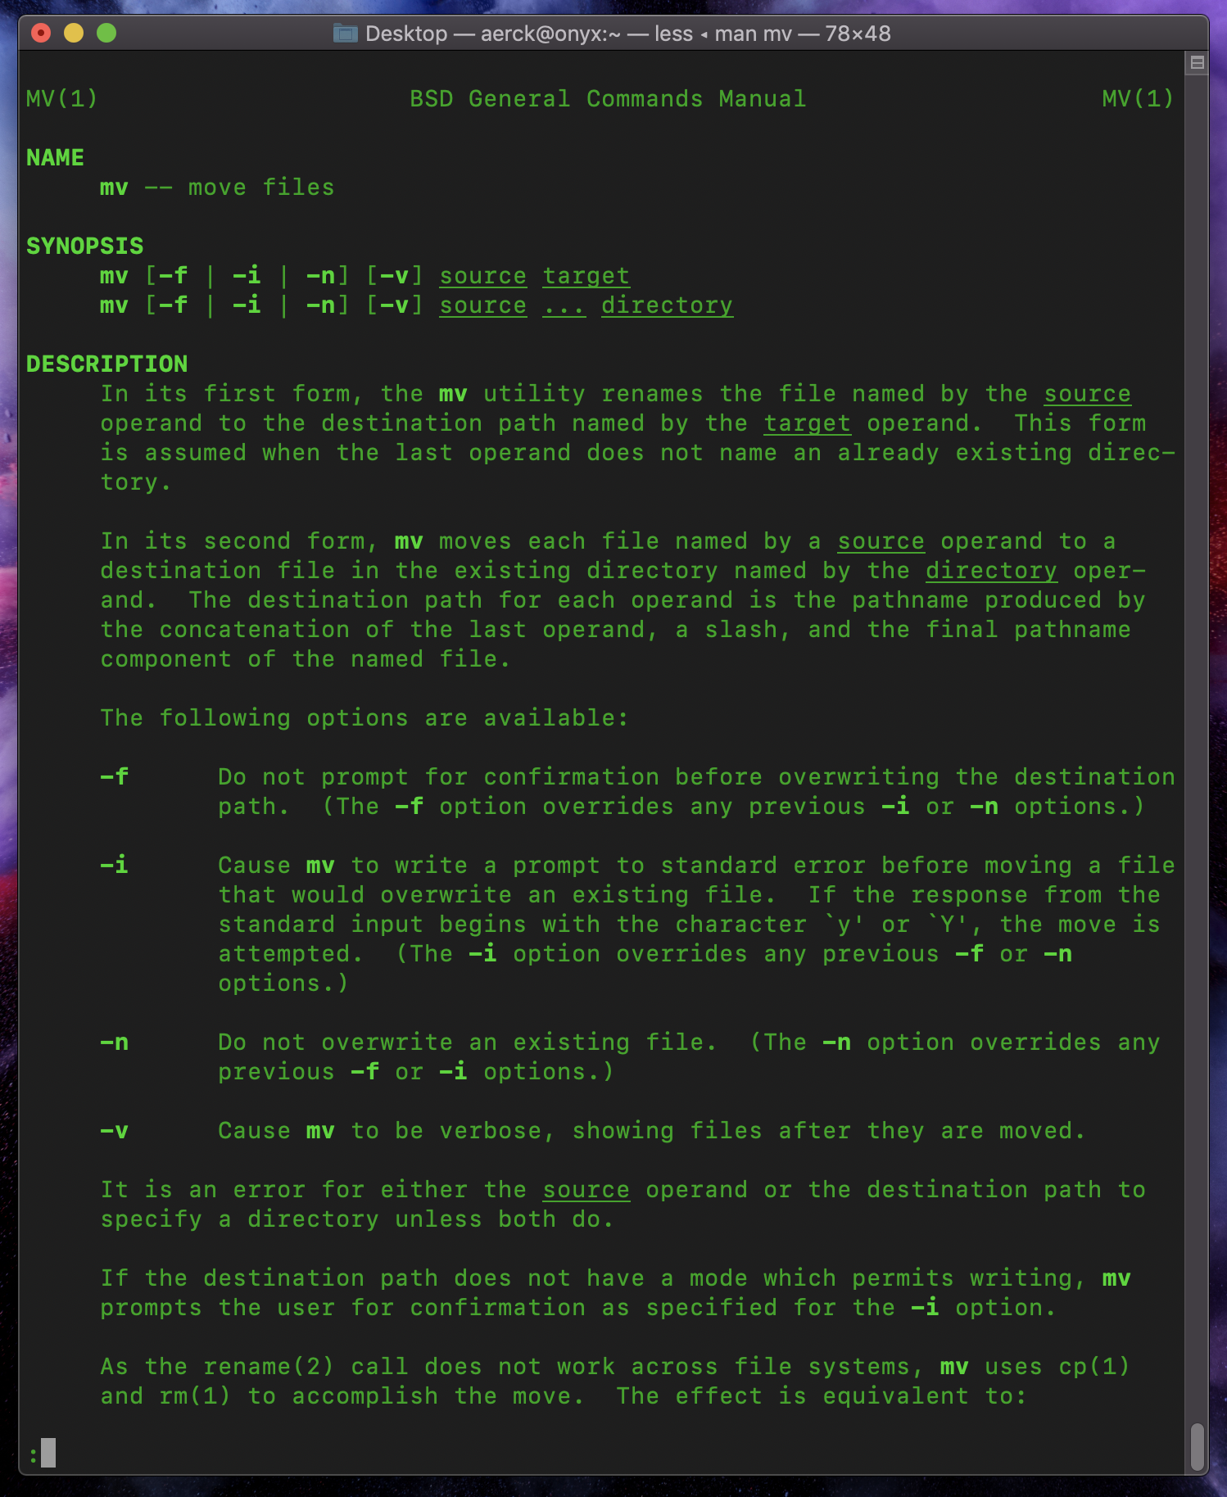
Intermediate
Changing directories also becomes much easier.
The move command has some other useful functions beyond just moving a file around.
We can rename a file with the move command like this: “mv My-Homework.txt groupwork.txt”
This WILL overwrite “groupwork.txt” if it already exists so be careful
Learn more about commands with “man mv” here man is short for manual. Type “q” to quit out of the manual page.

Slide 16
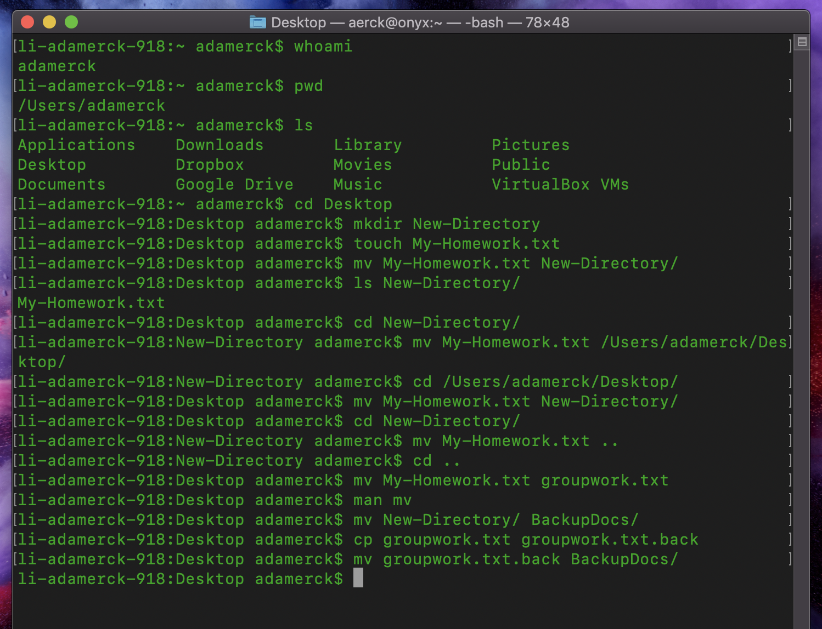
Intermediate
Next, we should be smart and create a backup of our group work, just in case someone loses it.
First rename our folder to something more useful “mv New-Directory/ BackupDocs/“
Now we create a copy of our group work using “cp groupwork.txt groupwork.txt.back”
Lastly, move our backup to our backups folder “mv groupwork.txt.back BackupDocs/“

Slide 17
Intermediate
Notes on previous slide:
File extensions, such as “.txt”, do not matter to Linux, thus, we can rename our backup files with non-sense extensions like “.txt.back” for our reference.
Both the “mv” and “cp” commands on the previous slide WILL overwrite data if the example files or folders already exist.
This can be avoided with command Options, which we will learn about next.

Slide 18
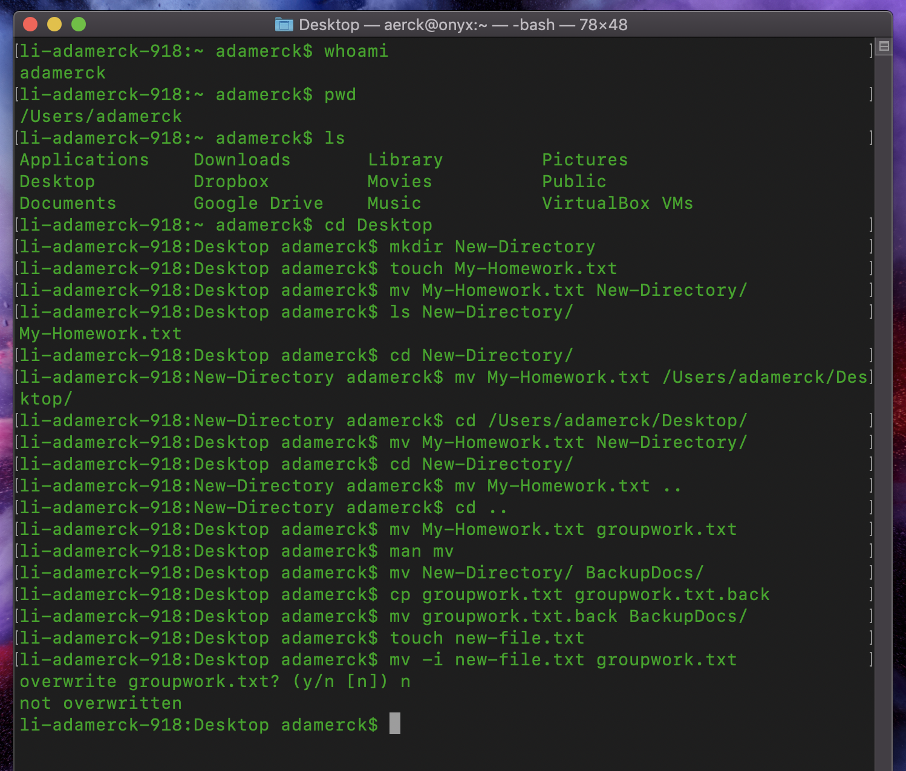
Intermediate
Most, if not all, of the shell commands you encounter have options that modify the behavior of the command.
You can learn about these options in the command’s man page.
Example with the “mv” command using the “-i” option for interactive
“touch new-file.txt”
“mv -i new-file.txt groupwork.txt”
As you can see, we get a warning about potential data loss, which we can choose to do or not to do.

Slide 19
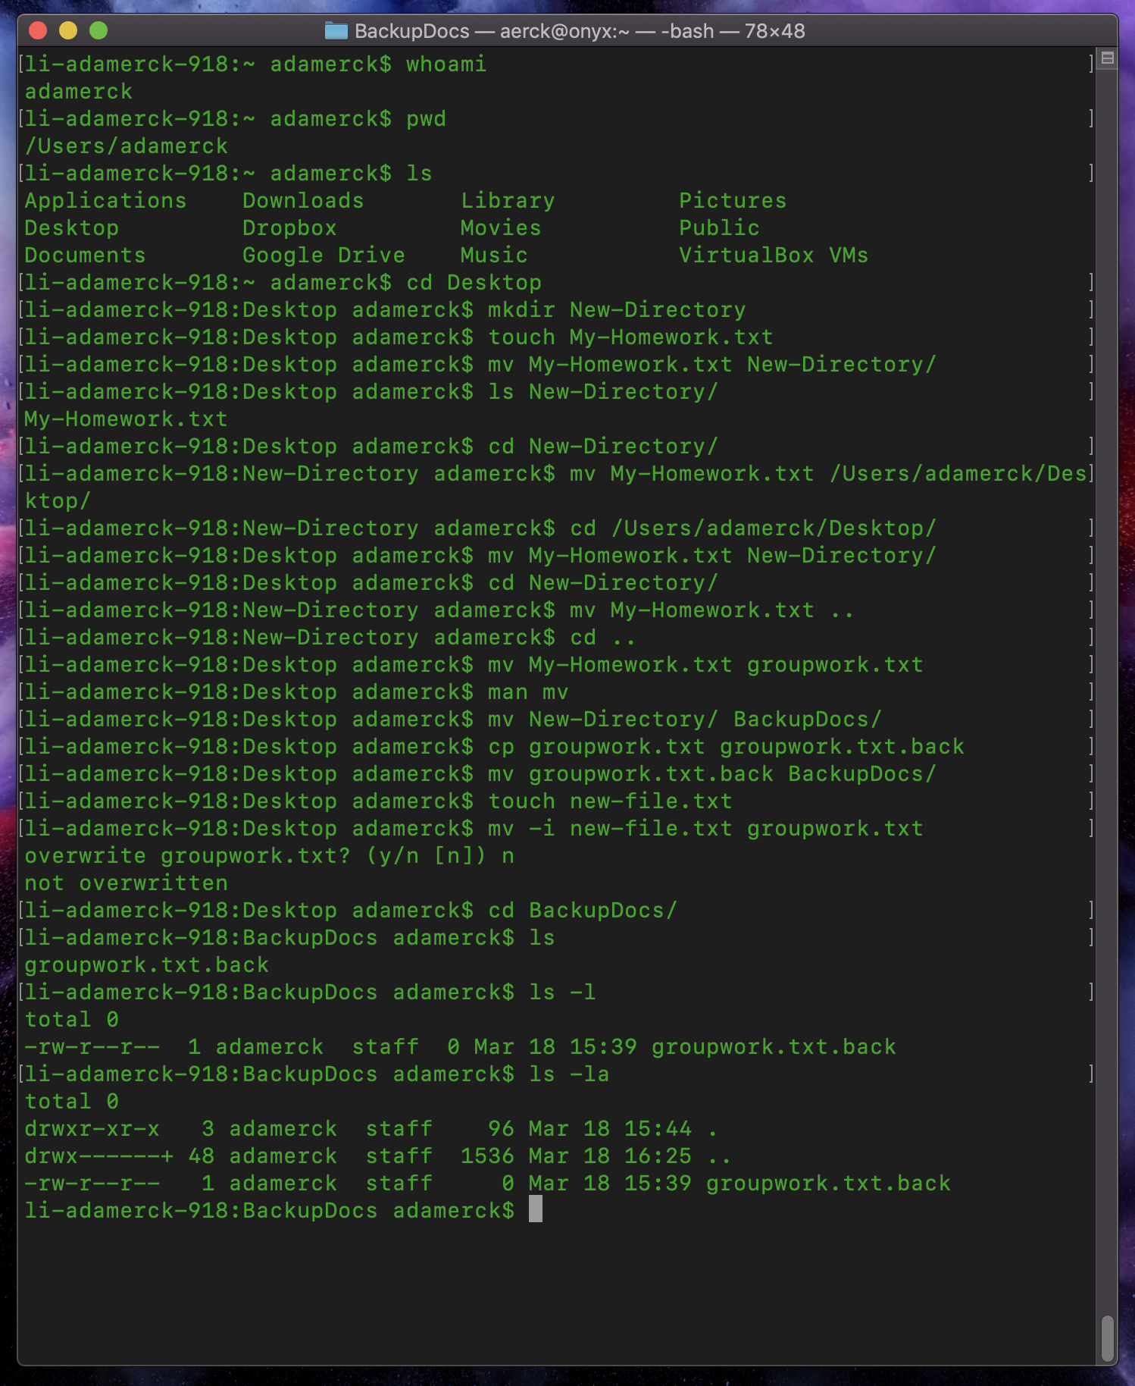
Intermediate
Another useful option is for the list command “ls”
With normal “ls” we don’t get a whole lot of information as you may have noticed.
Using “ls -l” we can see a Longer output from ls.
We can also combine multiple options
Using “ls -la” we can see a Longer output on All of the files in this folder, including the hidden ones.
Notice we now have a listing for the “.” And “..” Shortcuts

Slide 20
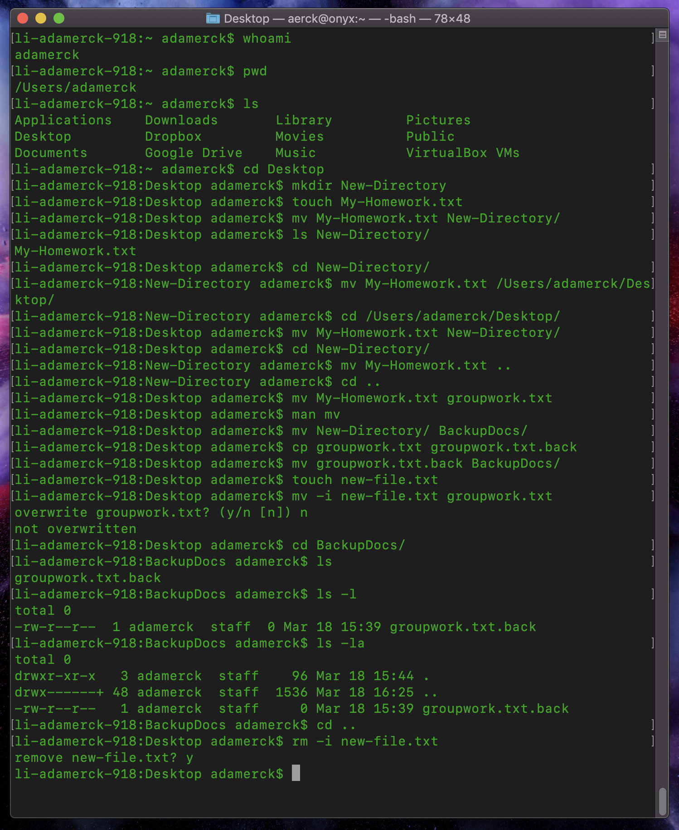
Intermediate
Now for cleaning up, which is Dangerous!
Linux assumes that you know what you are doing, so there is no "Recycle Bin” or “Trash Can” to pull files back out of.
Seriously be careful! You can literally undo MONTHS of work with a few key strokes, or possibly WRECK your computer.
We can Remove our new-file.txt for practice with “rm -i new-file.txt”
Again, to be safe I included the “-i” interactive option.

Slide 21
Intermediate
Great Work! You have now completed the “Intermediate” section on the Command Line Interface!
From here you are ready to move on to the Introduction to working on a Supercomputer Tutorial, otherwise, you can continue on here to the “Advanced” section.
Helpful tips to remember:
Be curious, open the man pages for the commands you learned here to learn more.
Be super careful when using the “rm” command as there is no undo. Test your delete command by first typing it with “ls” instead of “rm”. This way you see the list of files you are about to delete.

